Slide 2
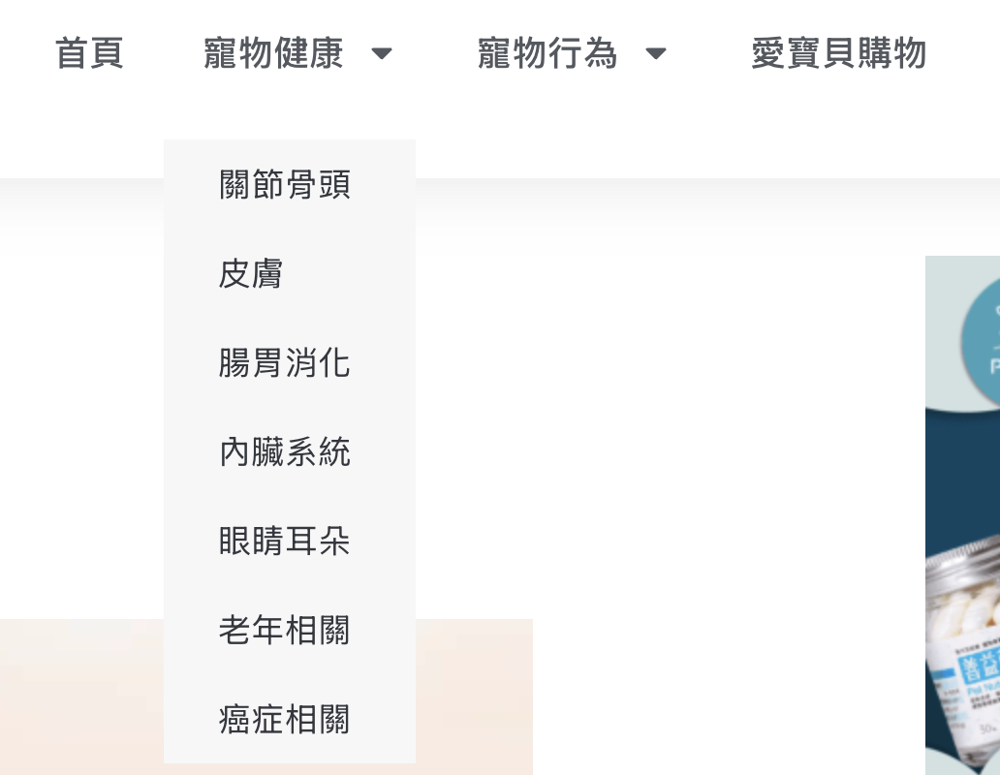
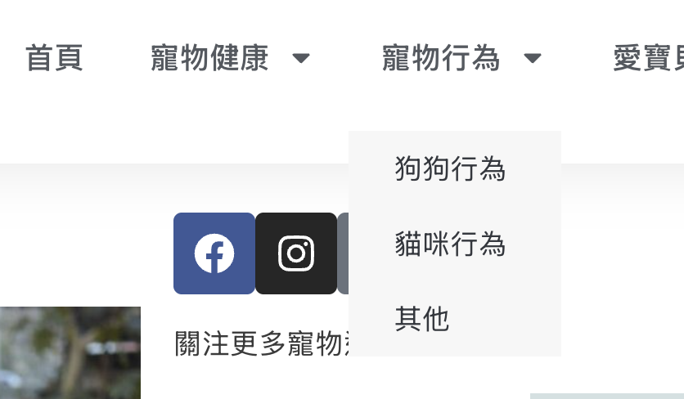
https://petmily.com/pet-behavior/
GOOD: 寵物健康與行為相關問題可列入參考
BAD :文章非有組織規劃 凌亂

Slide 3
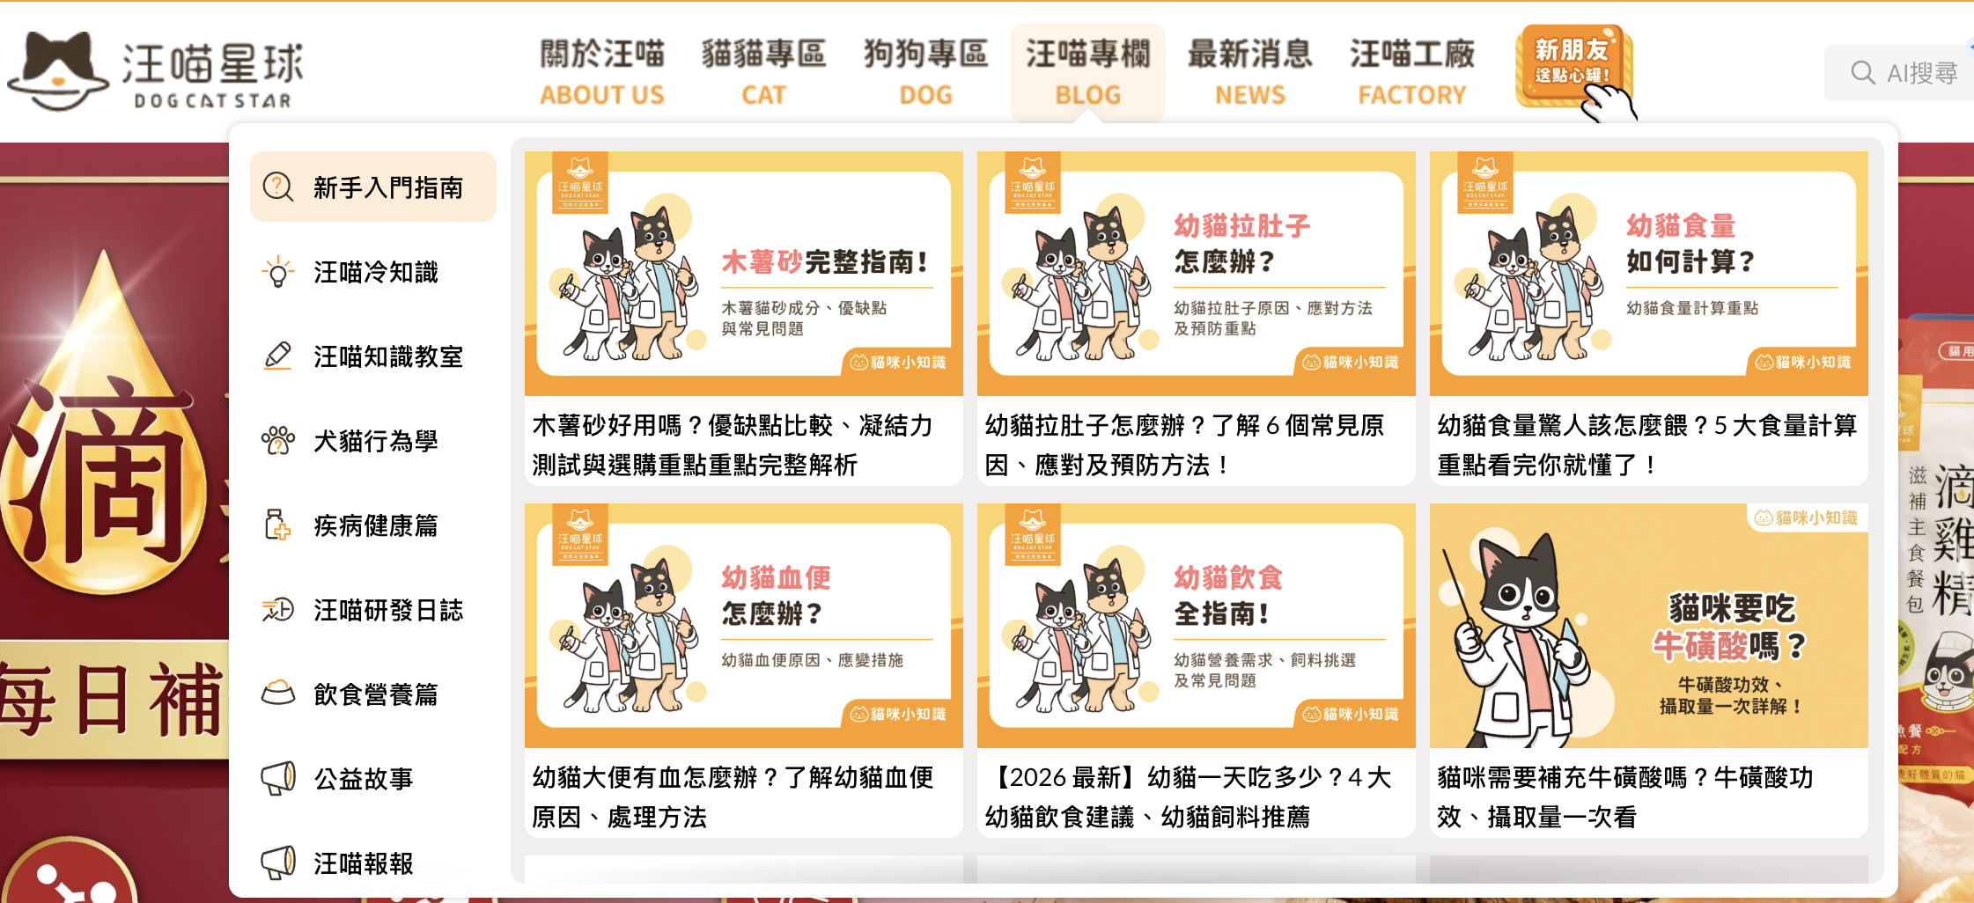
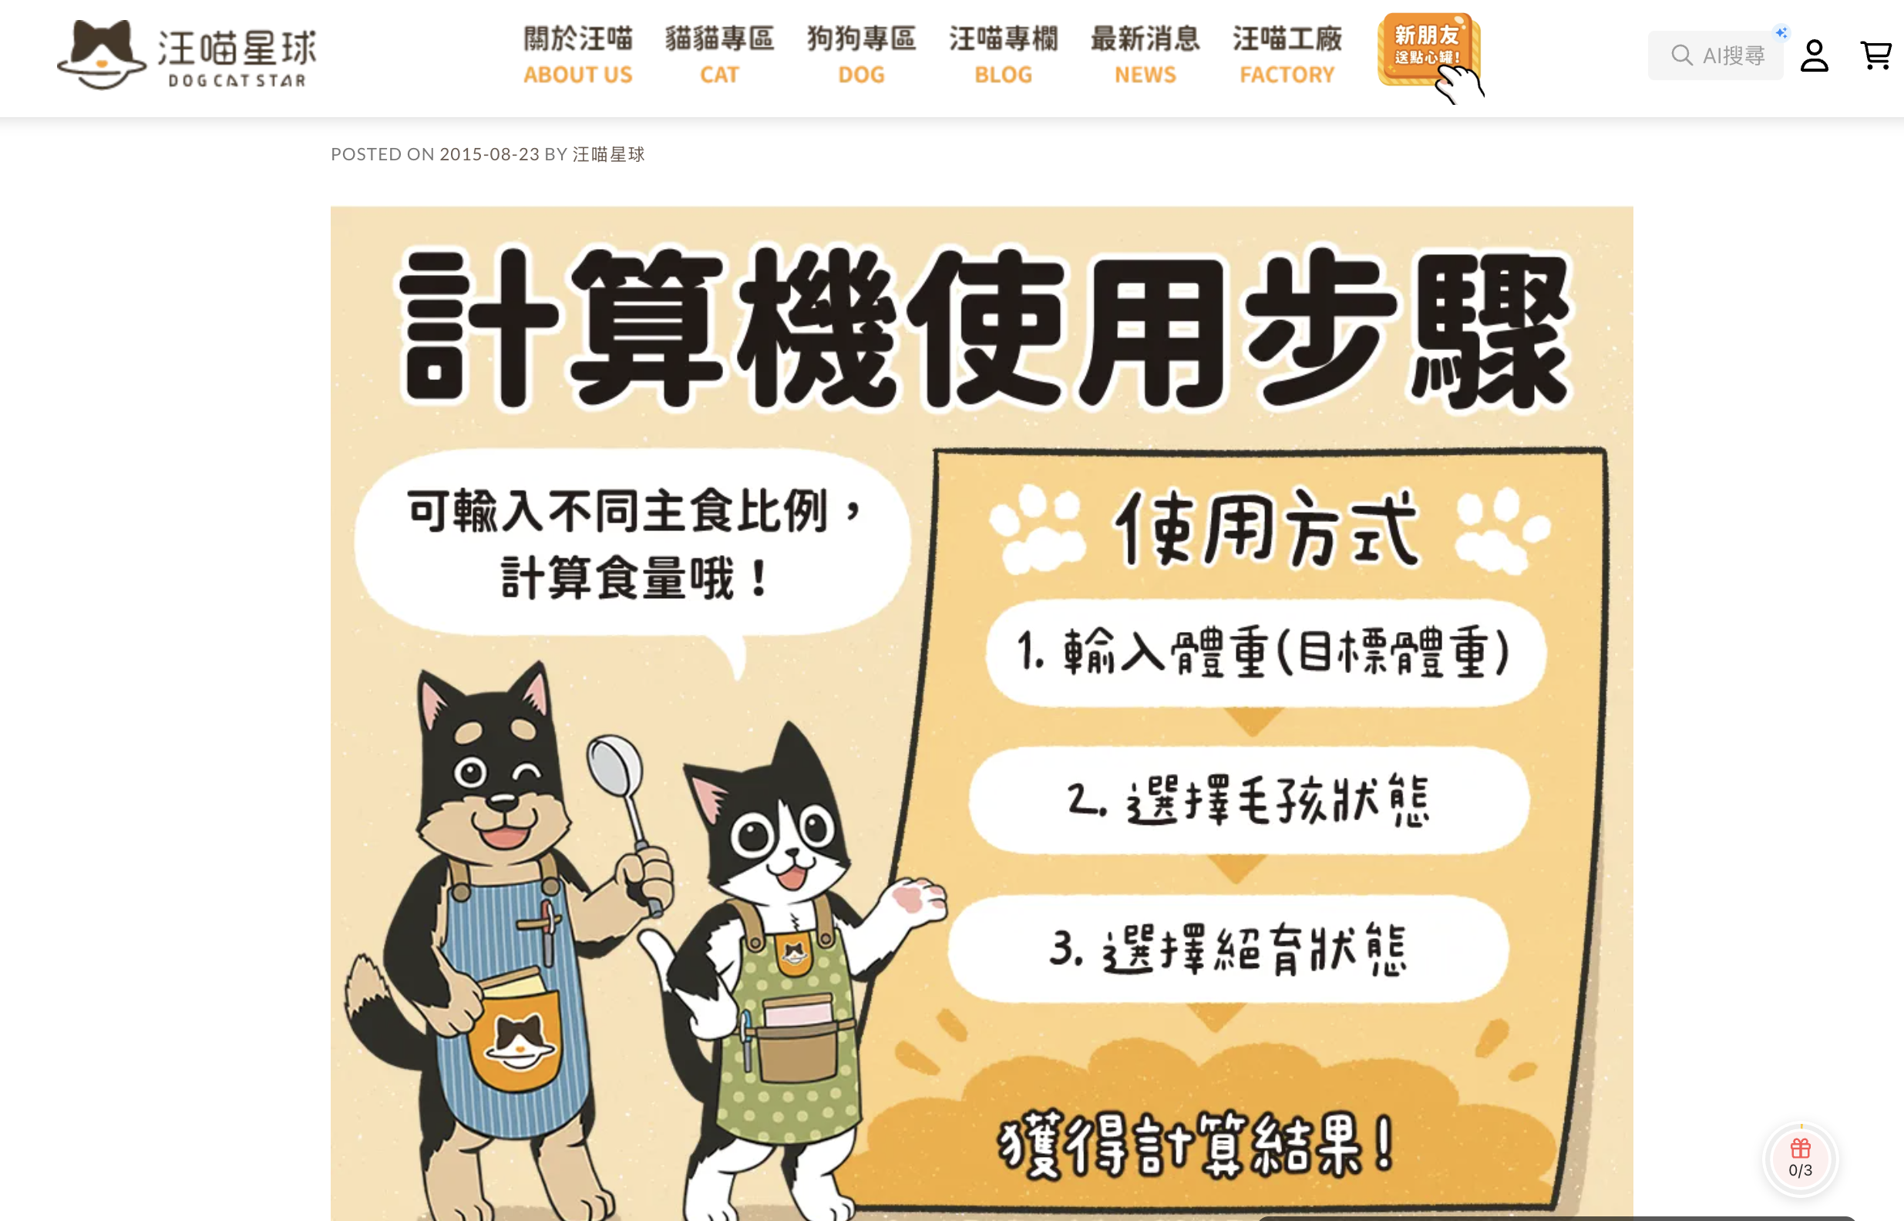
https://www.dogcatstar.com/

Slide 4

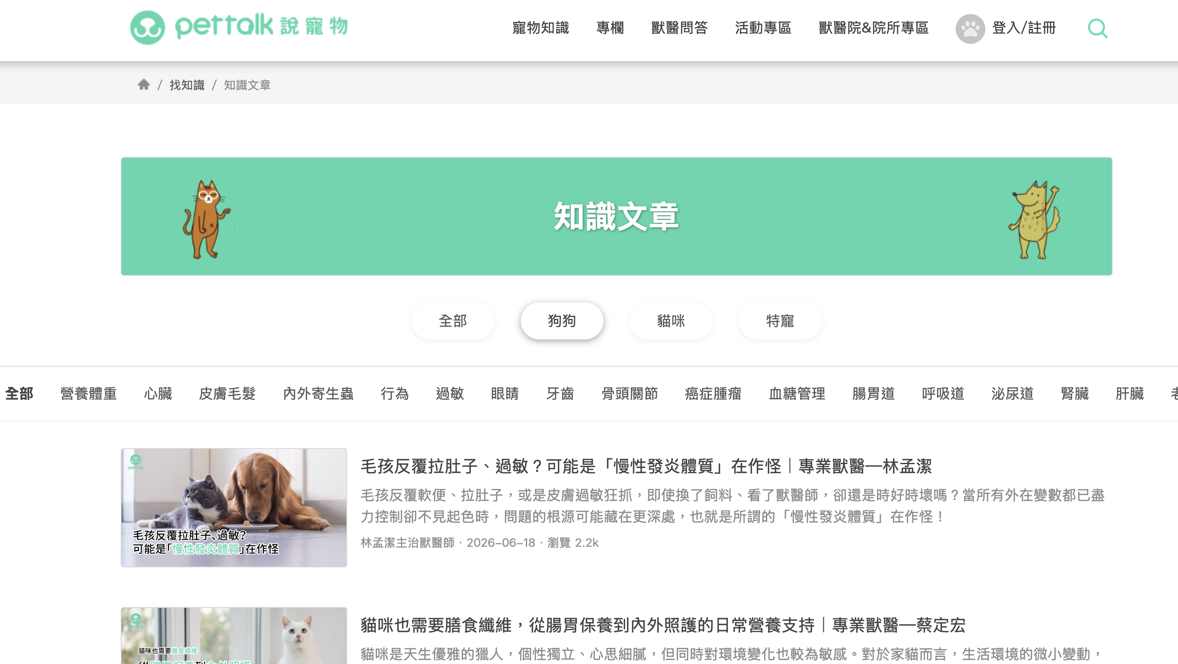

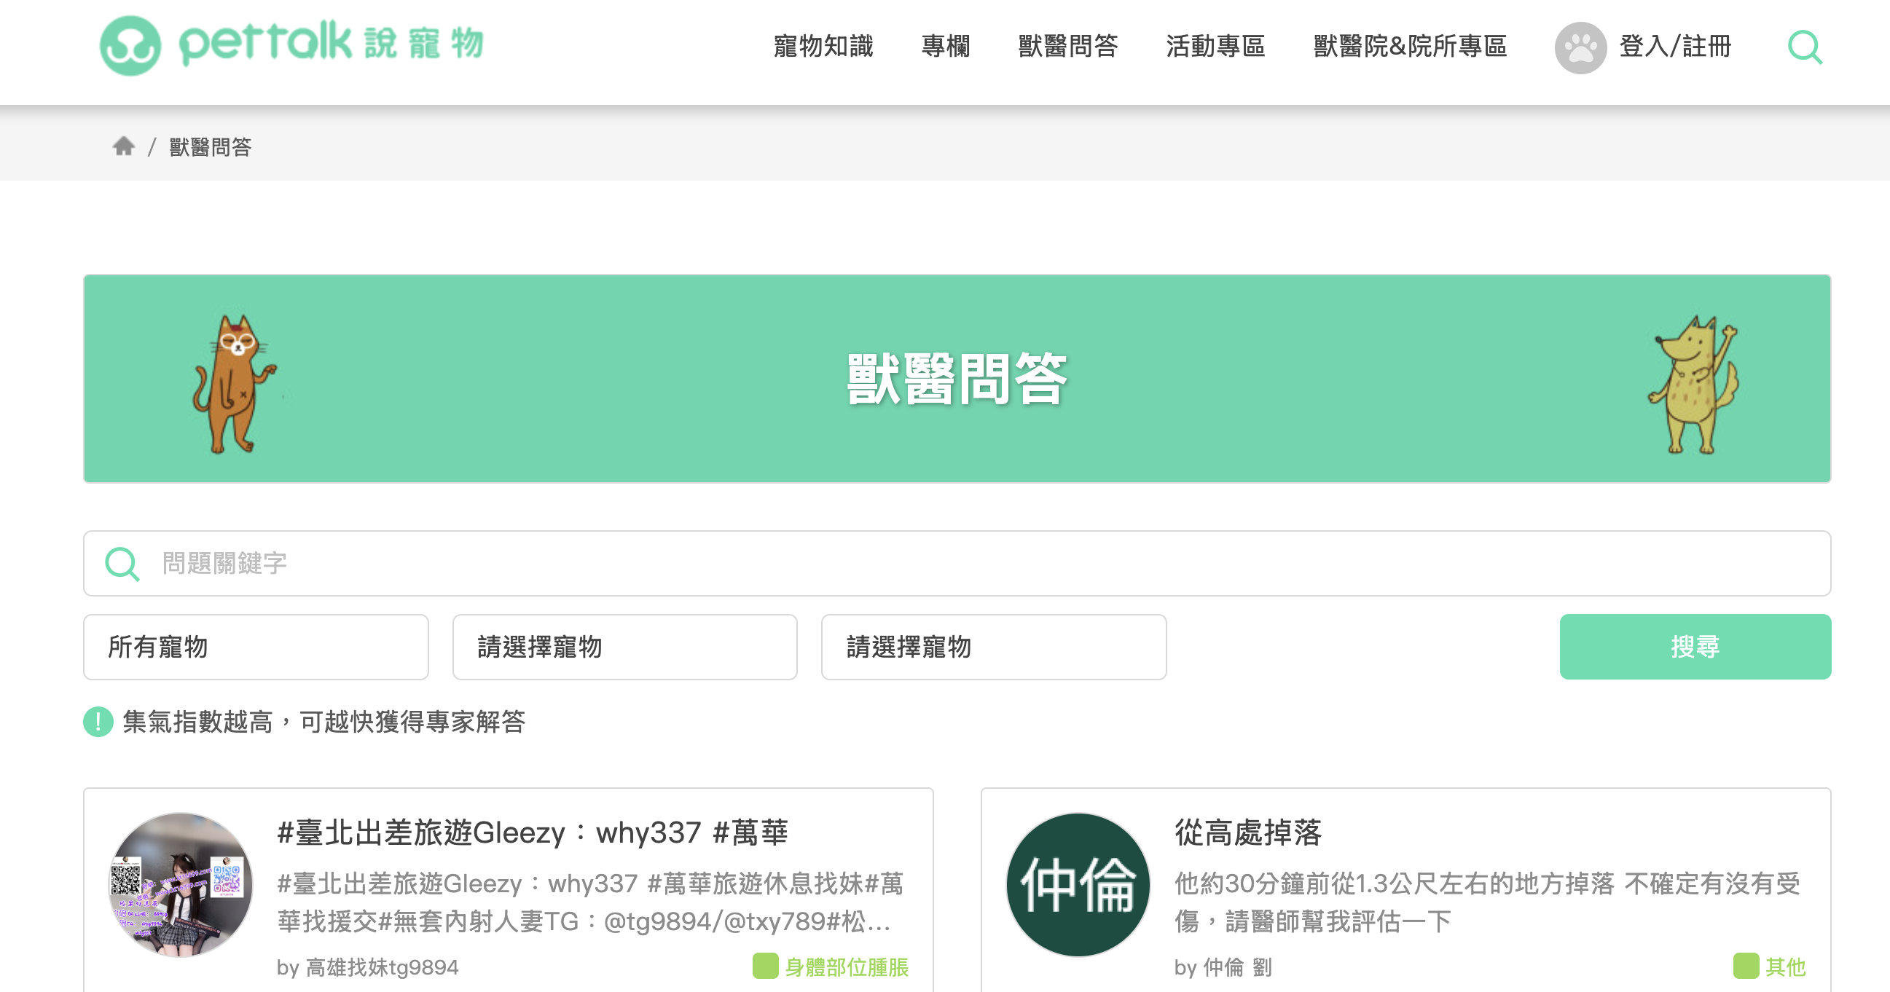
https://www.pettalk.tw/blog/type/article/2

Slide 5
https://maoup.com.tw/?p=30645

Slide 6
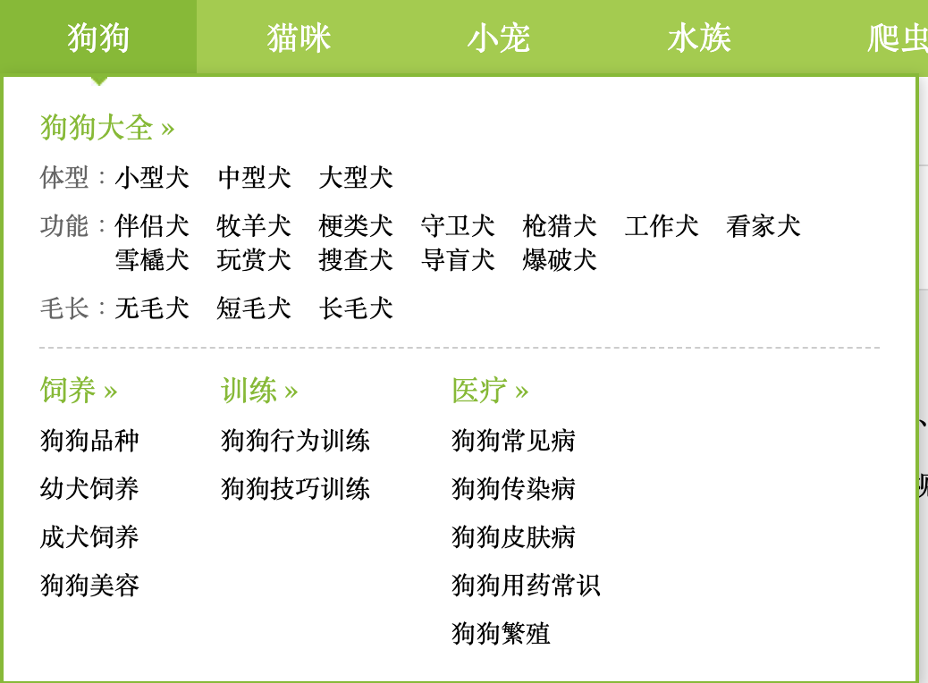
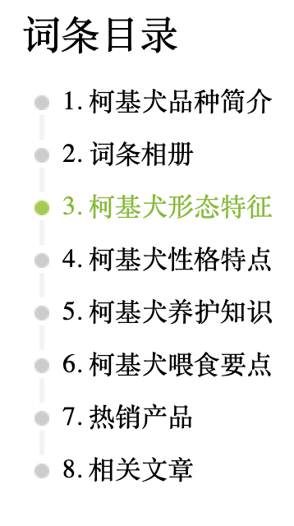
https://www.boqii.com/

Slide 7
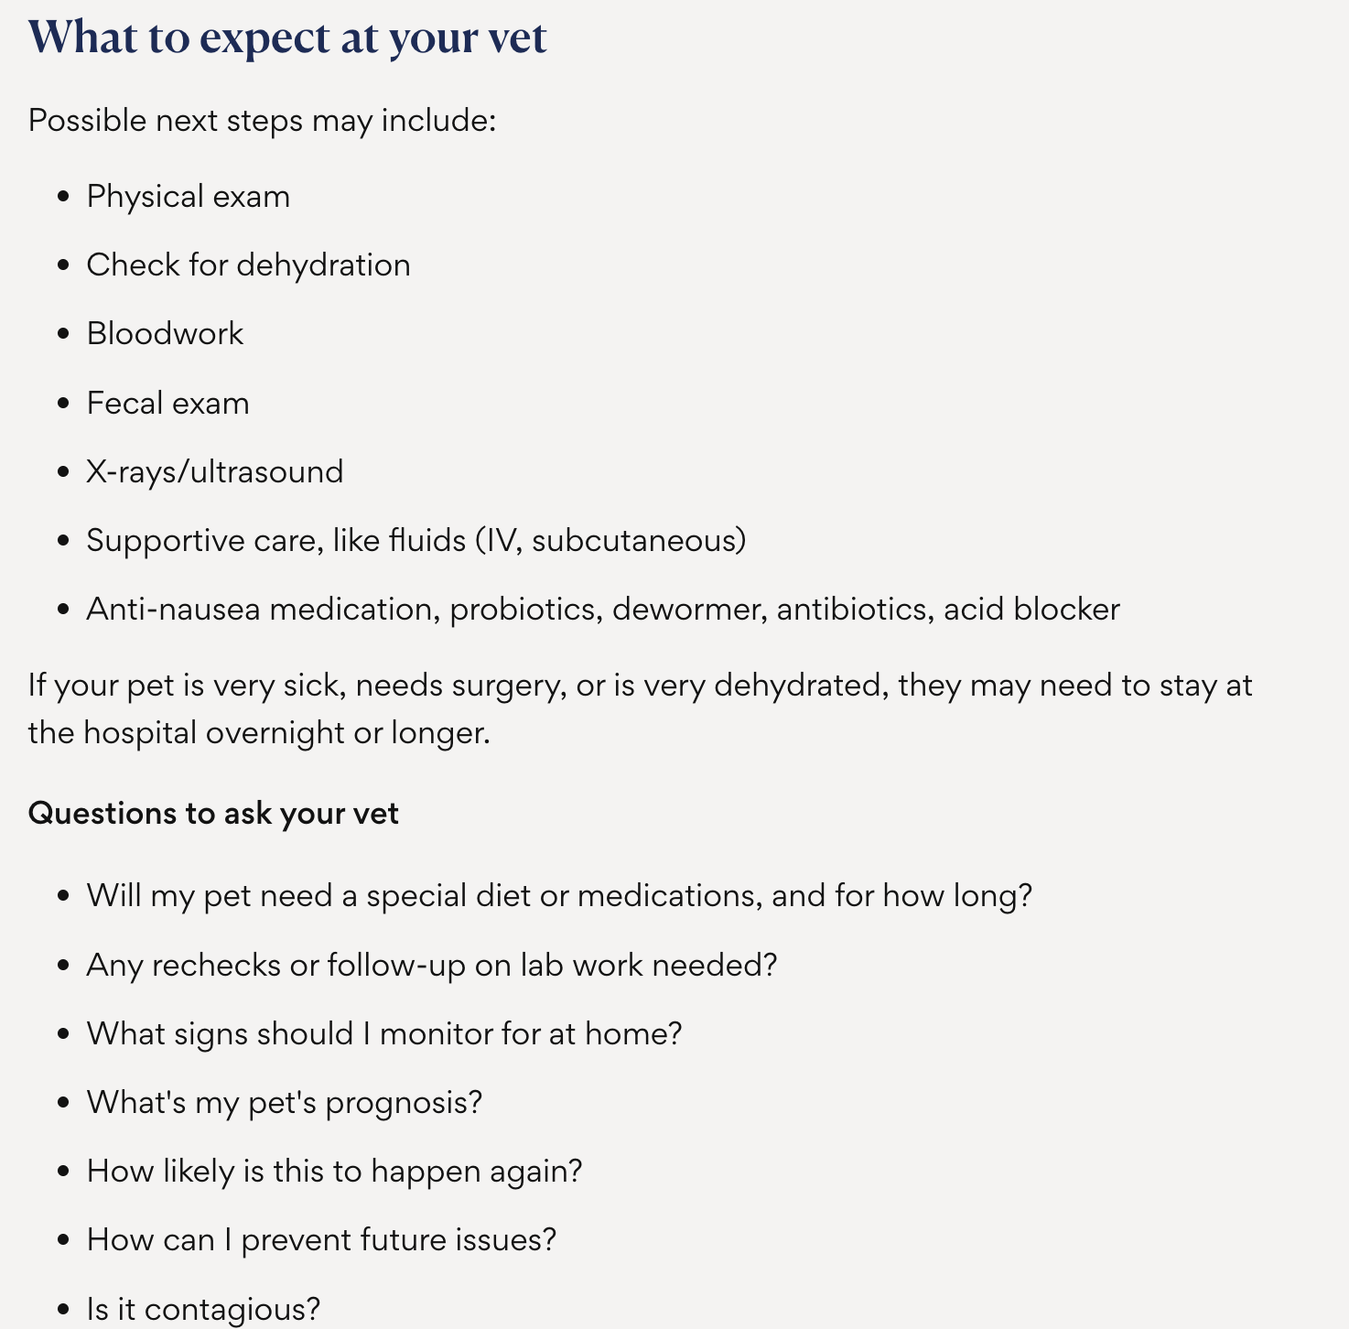
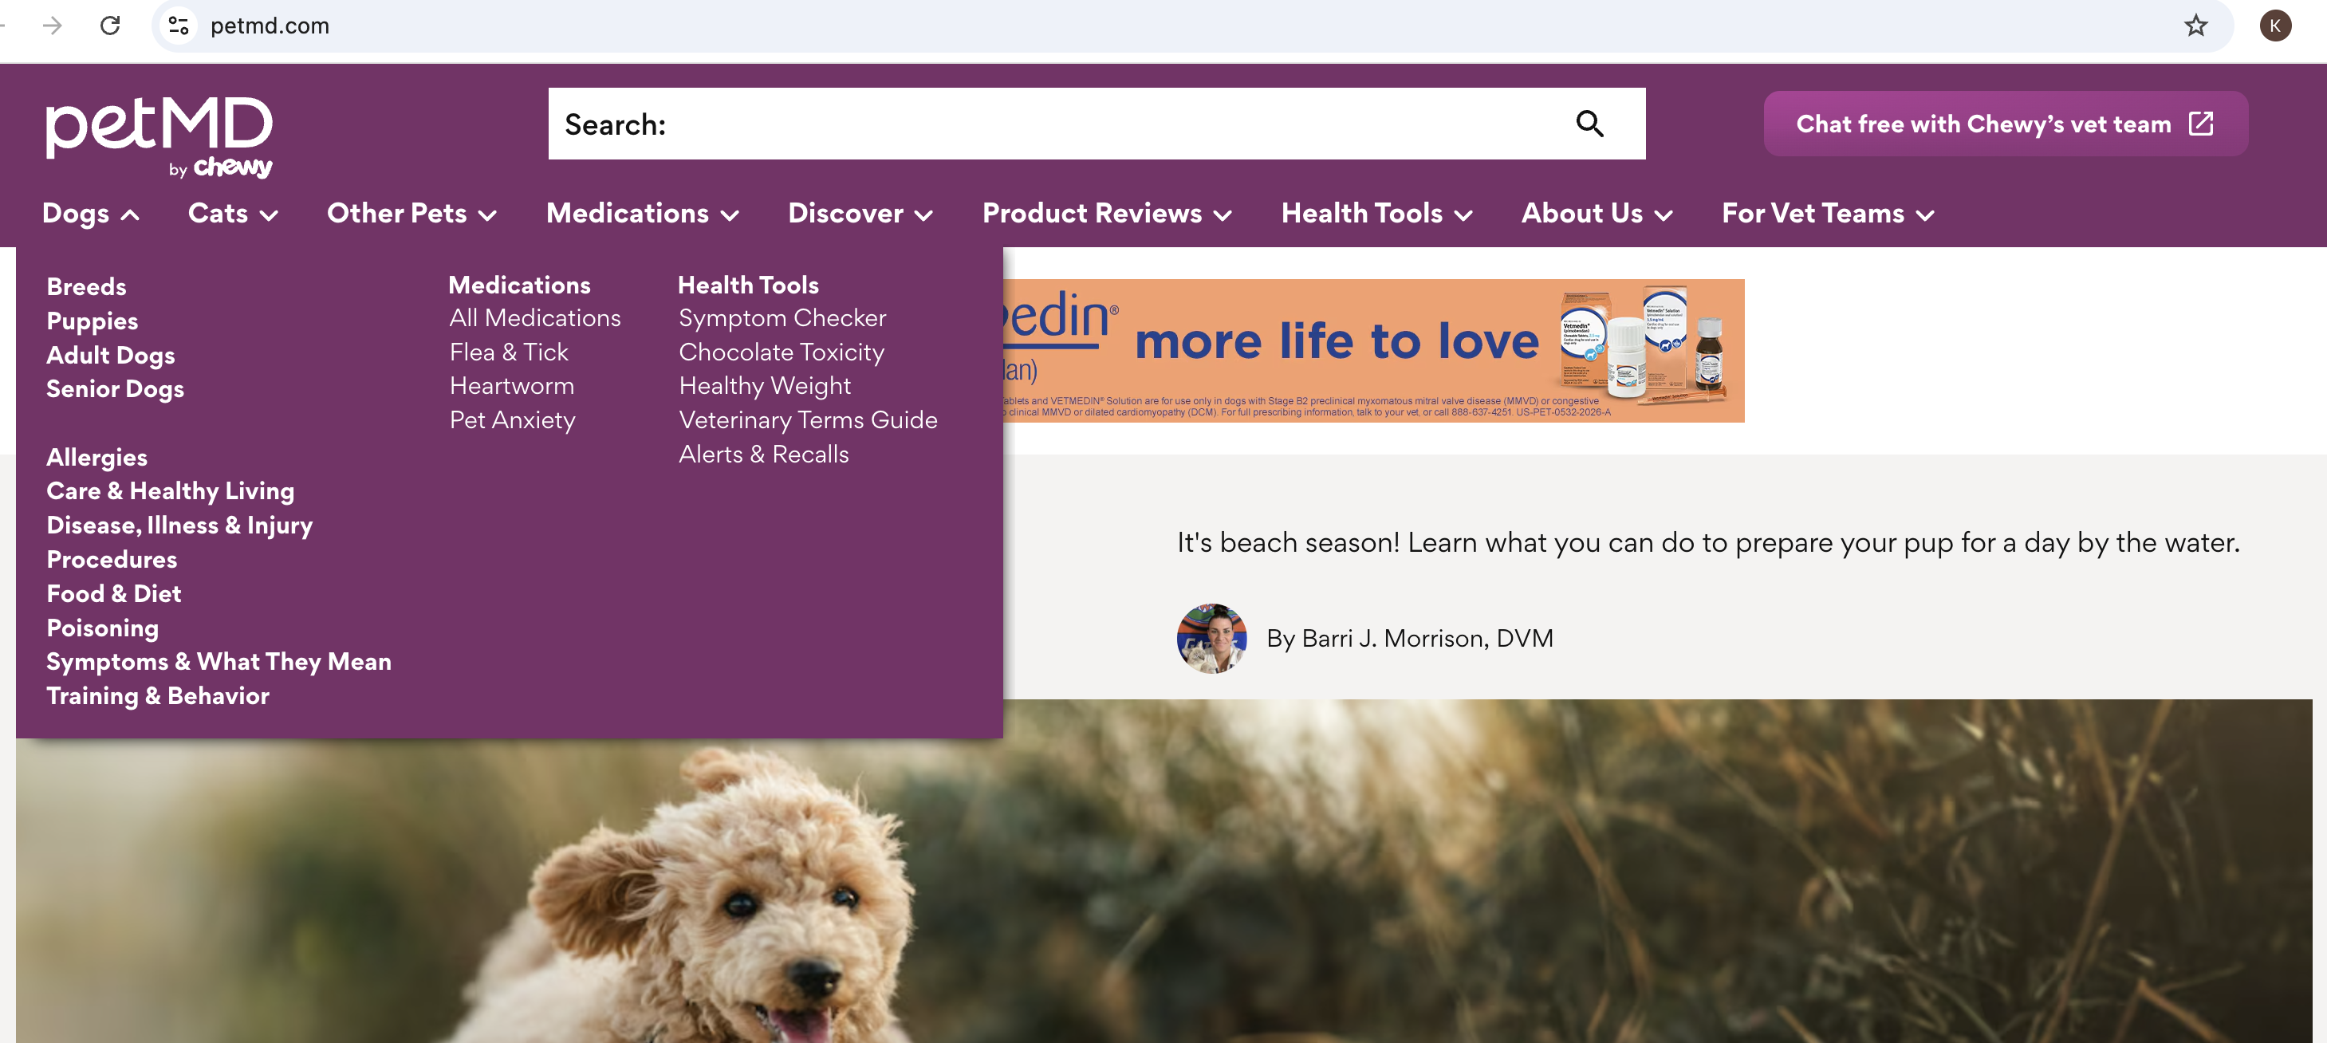
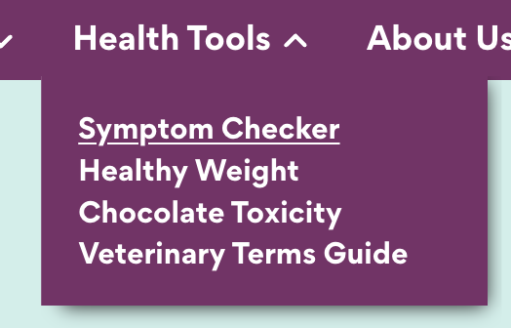
https://www.petmd.com/

Slide 8
